Slide 1


Insights into Category Performance

Slide 2


Today's agenda
Project recap
Problem
The Analytics team
Process
Insights
Summary

Slide 3

Social Buzz is a fast-growing technology unicorn that need to adapt quickly to 3-month global scale. Accenture has begun a 3-month POC focusing on these tasks:
An audit of Social Buzz’s big data practice.
Recommendations for a successful IPO.
Analysis to find Social Buzz’s top 5 most popular
categories of content.
Project Recap

Slide 4

Problem
We are addressing the challenge of understanding category performance based on user engagement scores. Specifically, we aim to identify the top-performing categories from our dataset to inform strategic decisions and enhance content effectiveness.
Analysis to find Social Buzz’s top 5 most popular categories of content

Slide 5



Maria Fleming
Chief Technical Architect
Marcus Rompton
Senior Principle
Myself
Data Analyst
The Analytics team

Slide 6
Process
1
Data Understanding
2
Data Cleaning
3
Data Modelling
Data Analysis
4
5
Uncover Insights

Slide 7

Key Insights from the Analysis
Top-Performing Categories
Total Score: 74965
Key Drivers: High user engagement due to relatable content and emotional connection with animal-related topics.
Total Score: 71168
Key Drivers: Increased interest in educational content, particularly in areas like technology and environmental science.
Total Score: 69339
Key Drivers: Growing awareness of health and wellness, leading to higher engagement with recipes, nutrition tips, and lifestyle content.
Animals
Science
Healthy eating

Slide 9
Recommendations for Future Strategy
Focus on High-Performing Categories:
Animals: Increase the production of engaging animal-related content, such as videos, stories, and user-generated content.
Science: Develop educational series or collaborations with experts to create more in-depth science content.
Healthy Eating: Expand the range of healthy eating content, including meal prep videos, nutrition workshops, and interactive challenges.
Enhance Underperforming Categories:
Analyse feedback on lower-scoring categories to identify content gaps and areas for improvement.
Consider user preferences and trends to refine content strategy.

Slide 10

Identified the top 5 scoring categories: Animals, Science, Healthy Eating, Technology and Food.
Highlighted key trends indicating strong user engagement in these areas.
Provided actionable recommendations for leveraging insights to enhance content effectiveness.
Summary

Slide 11
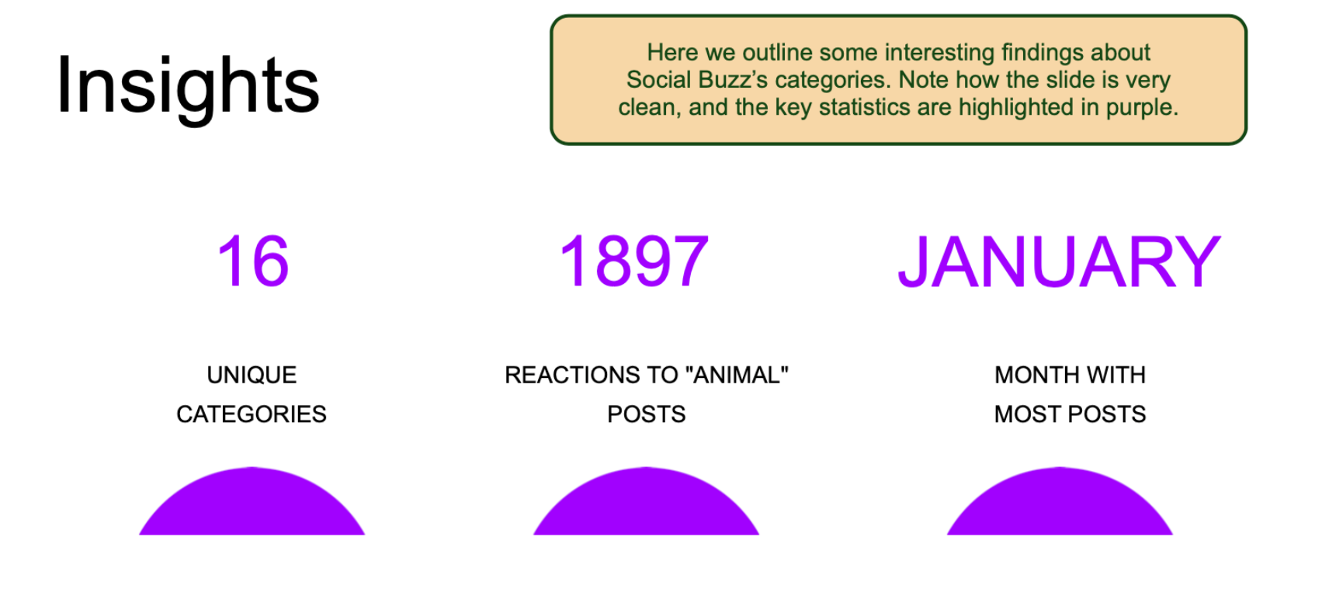

Slide 12
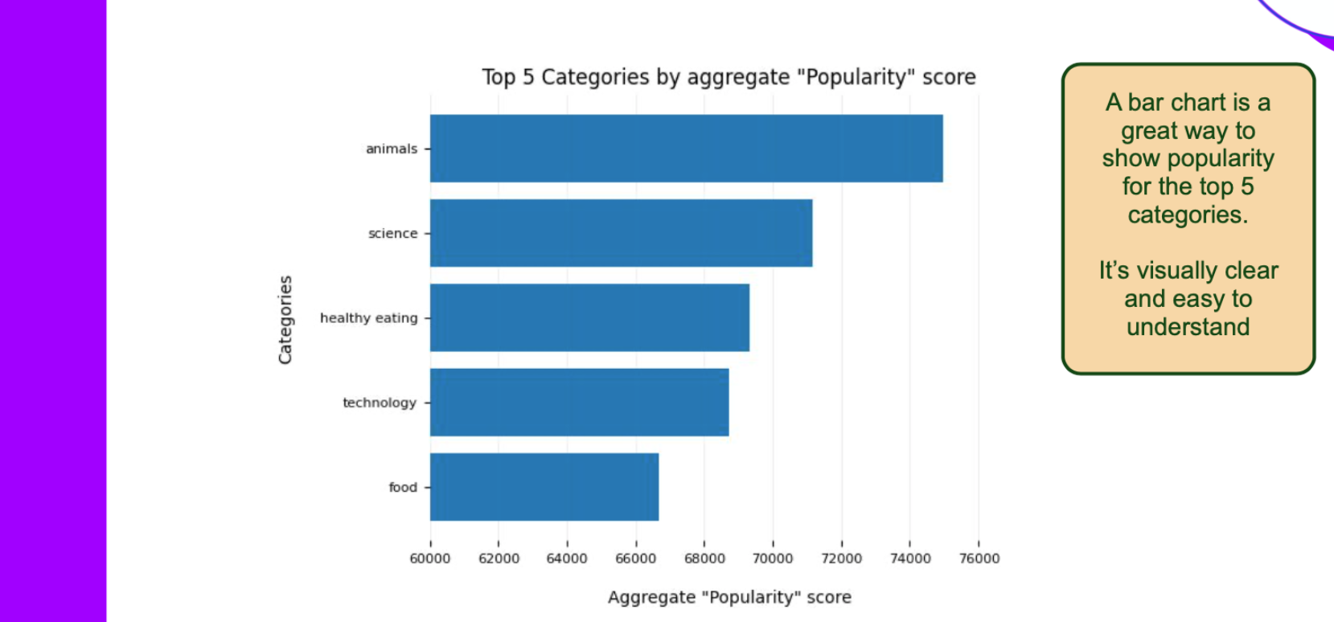

Slide 13
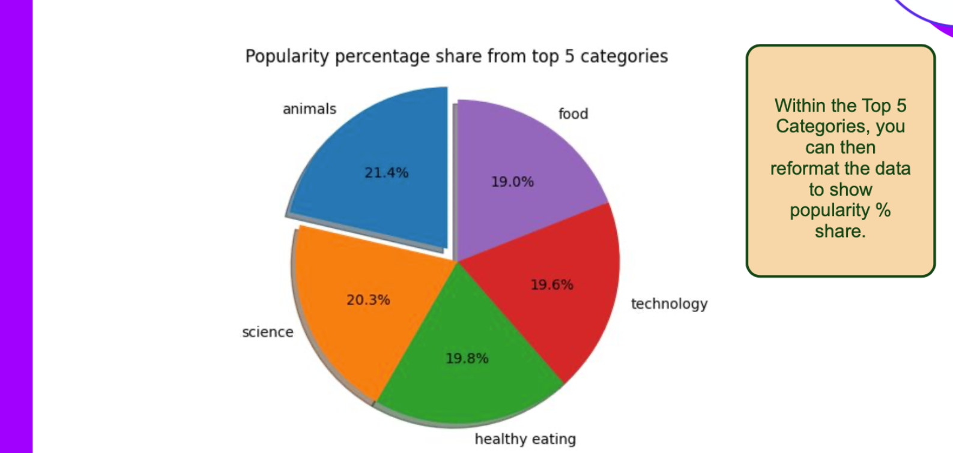

Slide 14
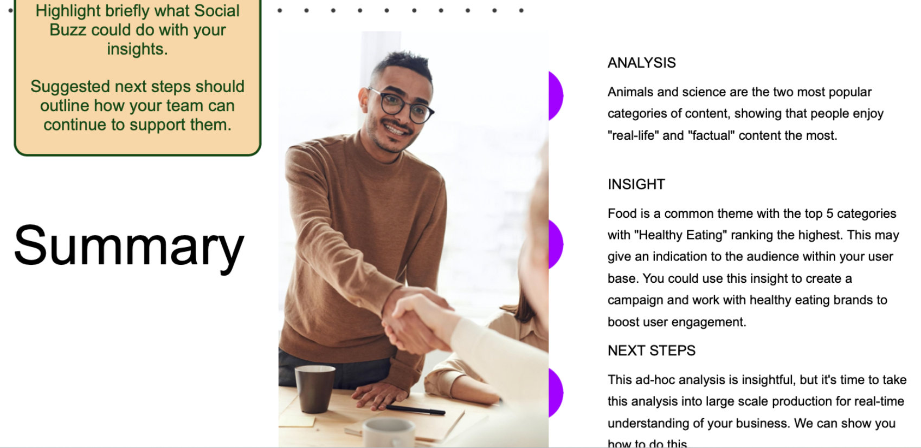

Slide 15
Thank you!
ANY QUESTIONS?

